Slide 1


Image and Data Integration Using Spatial Point Processes
Kasthuri Kannan, PhD
Associate Professor
Translational Molecular Pathology
UT MD Anderson Cancer Center

Slide 2
Who thinks mathematics is awesome?

Slide 3

Banach-Tarski paradox
It is a theorem in mathematics!!
Are we living in the world of matrix?

Slide 4
Contents
Introduction to Spatial Point Processes
Point process methods, CSR
Conditional intensity
Gibbs, Strauss and Geyer models
Omics Data Integration
Marked point process
Histopathology image segmentation
Power of spatial point process modeling
An Application of Spatial Point Process
Case study: Glioblastoma multiforme
K and L functions
Contact inhibition of locomotion

Slide 5
Introduction to Spatial Point Processes

Slide 6
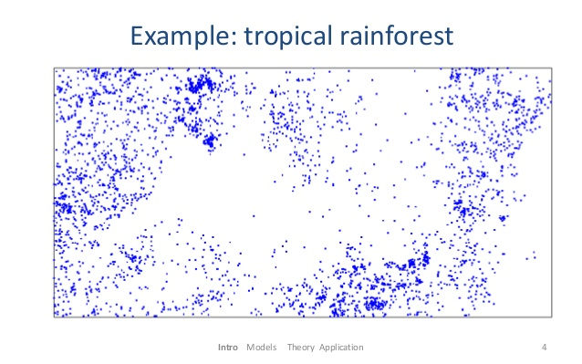
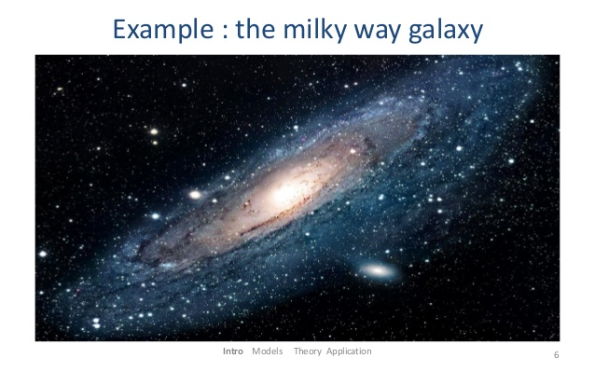
Motivation
A collection of points in space, R^{d}, d >= 2. The arrangement of points is called a pattern.
Are the points uniformly spread over the survey region?
Does the density of points depend on an explanatory variable?
Are the points randomly scattered?
Is there evidence of clustering?
Is the spatial pattern consistent with my scientific hypothesis?
How reliable is my statistical analysis?
Adrian Baddeley, Ege Rubak, Rolf Turner. Spatial Point Patterns. Chapman & Hall/CRC

Slide 7
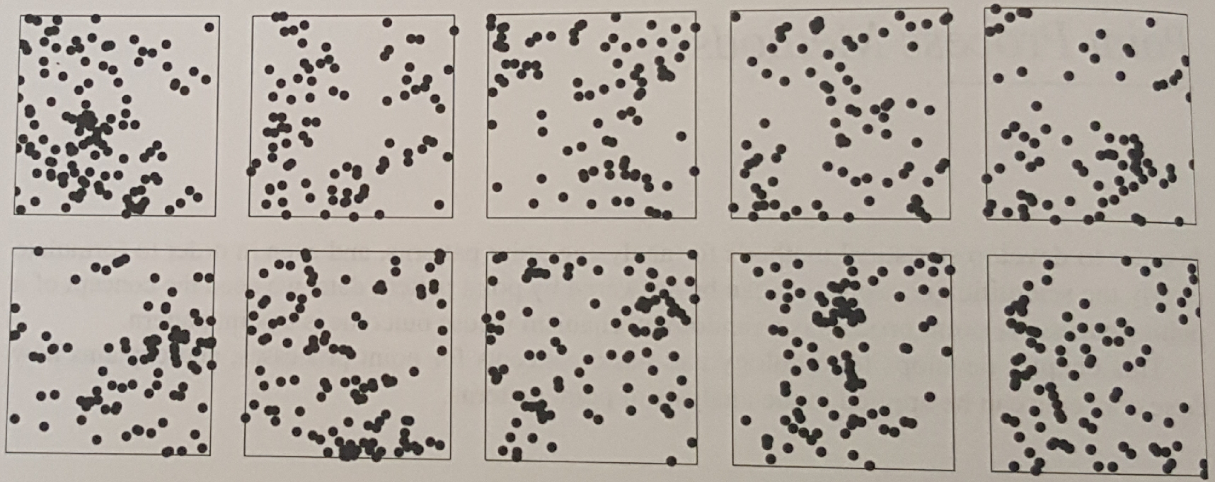
Point Process
Not about points themselves
How the points were generated on the first place?
Random variable
Numerical quantity that is observed/measured
“Inherently variable” – measurement errors, sampling variability etc.
Point process
A random mechanism whose outcome is a point pattern
Same process could lead to different point patterns (realizations)
Adrian Baddeley, Ege Rubak, Rolf Turner. Spatial Point Patterns. Chapman & Hall/CRC

Slide 8
The Binomial Process
Number of points, n, is constant and are spread in independent random locations:
The points are uniformly spread over a region W
W
n=9
For a given region B in W, we need to determine the probability distribution,
We can model X_{i} as success/heads if it belongs to B, otherwise failure/tails
B
W

Slide 9
Complete Spatial Randomness (CSR)
Homogeneity: the points have no preference for any spatial location
Independence: information about the outcome in one region of space has no influence on the outcome in other regions of space
Binomial process does not have the property of spatial independence.
Given k points in a region and total n points, n-k points lie in the complement of the region
CSR is a realistic model for several phenomena, radioactive decay, rare events, extreme events etc.
Null model
What is the probability distribution of CSR?

Slide 10
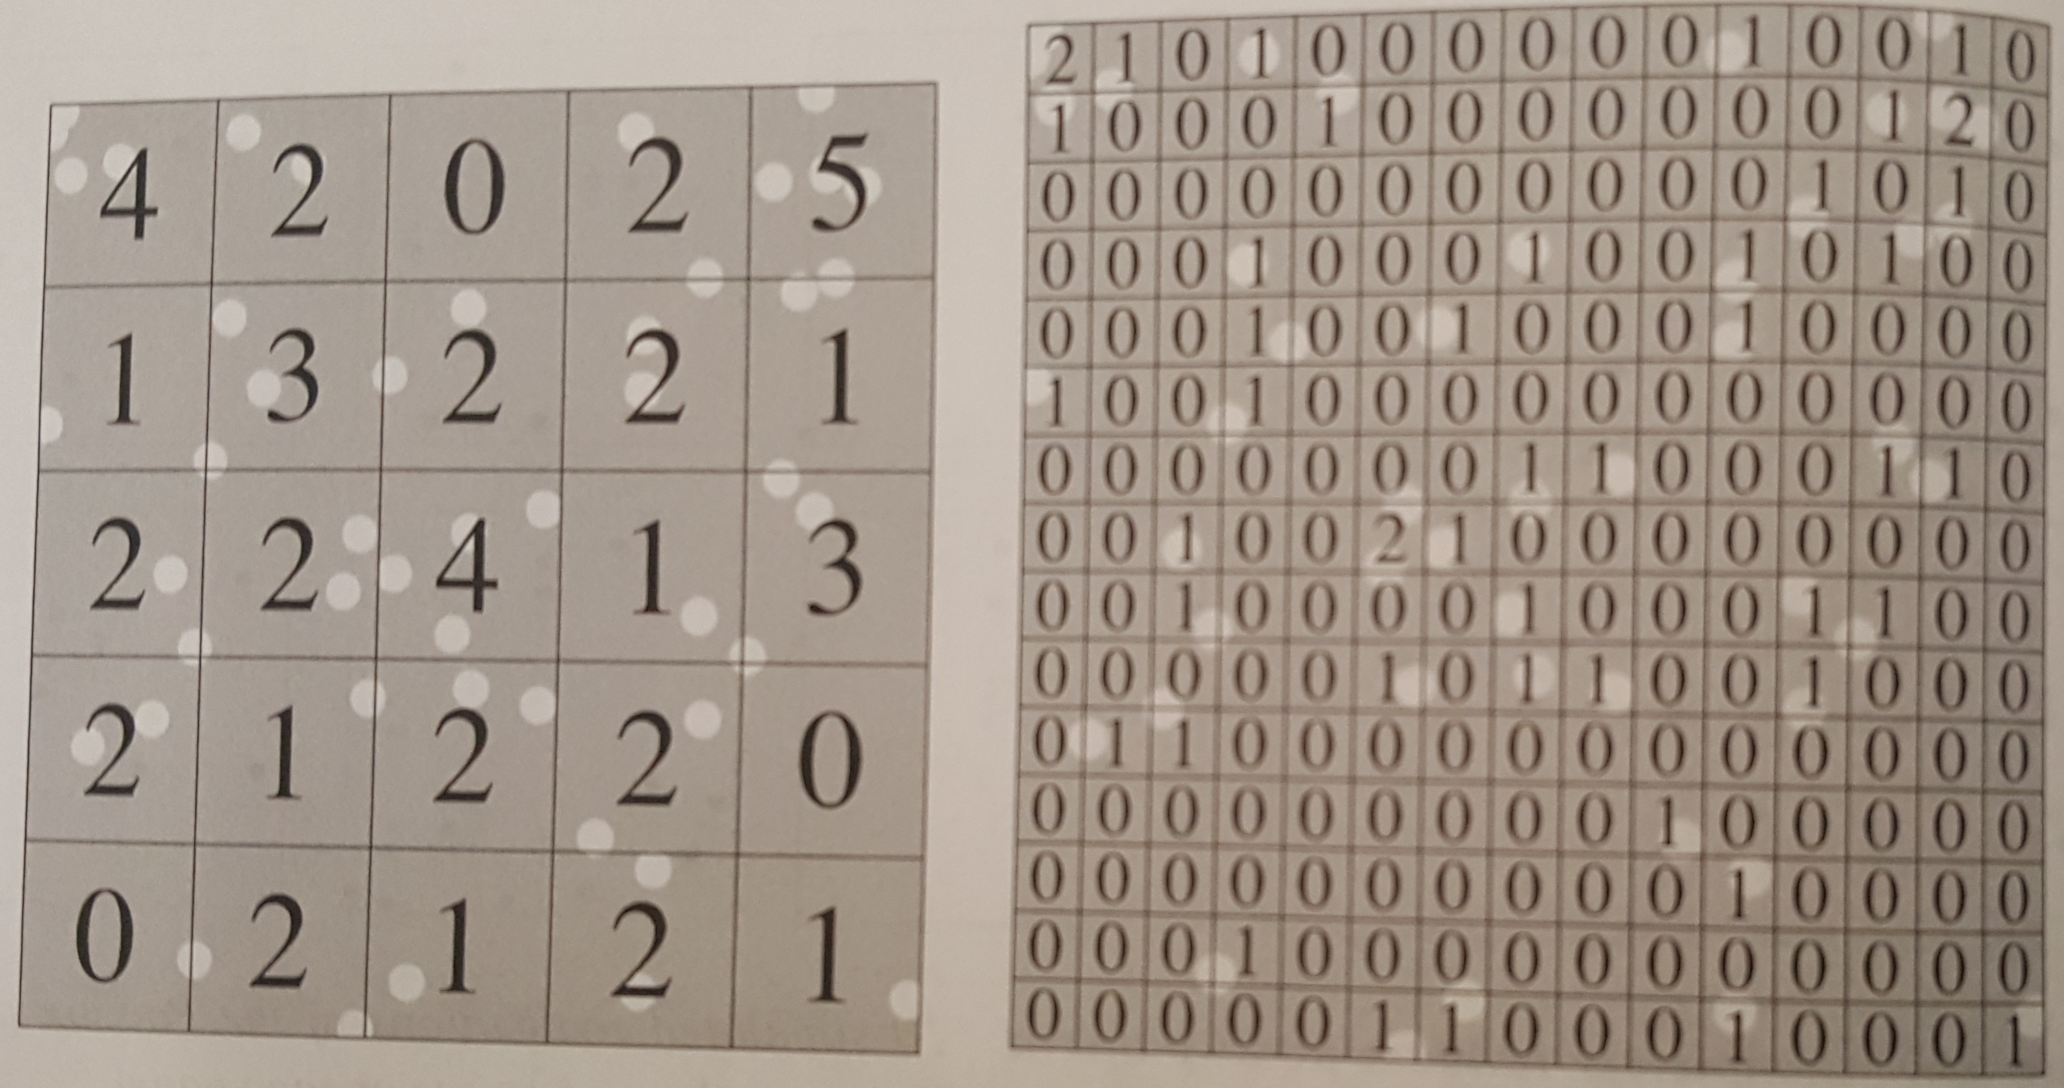
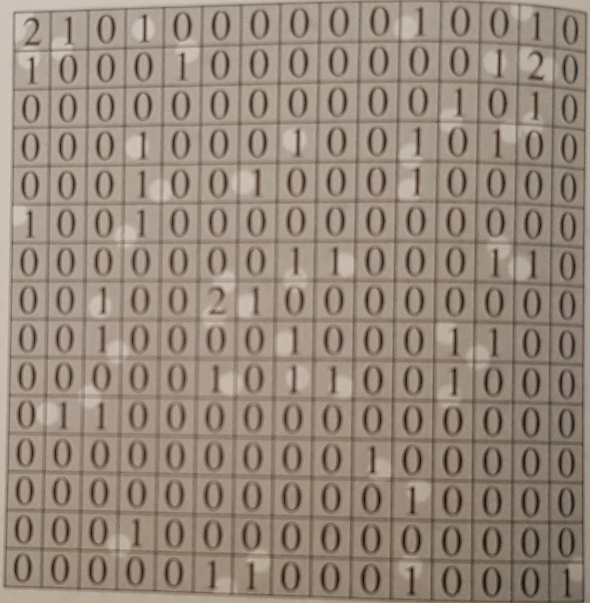
Homogeneous Poisson Process
Homogeneity:
Independence assumption applies to any disjoint regions of space
X
A
= number of successes in a large number of independent trials, each trial having a small probability of success
Famous result in probability theory, has a Poisson distribution,
Thus, CSR = Homogeneous Poisson Process
Adrian Baddeley, Ege Rubak, Rolf Turner. Spatial Point Patterns. Chapman & Hall/CRC

Slide 11
Inhomogeneous Poisson Process
Most important model for practical purposes
Modification of the CSR in which the average density of the points is spatially varying
Thus, instead of we have for any spatial location u and the expected number of points in a region A is given by,
Simulation of inhomogeneous Poisson process
Given λ(u), find M such that λ(u) <= M
Generate a homogeneous Poisson process with intensity M
For each random point x_{i} that was generated, evaluate the probability p_{i} = λ(x_{i})/M
Randomly delete or retain the x_{i} with retention probability p_{i}, independently of the fate of other points
Resulting simulation is an inhomogeneous Poisson process with intensity λ(u)
Therefore, given a point pattern we can determine the intensity at various quadrats, simulate an inhomogeneous Poisson process and compare with original data set (Monte Carlo tests) using appropriate test statistic

Slide 12
Common Parametric Models of Intensity
Nonhomogeneous Poisson process a key model
– several popular techniques are equivalent to fitting a Poisson point process model
Homogeneous intensity:
Homogeneous in different regions:
Intensity proportional to baseline:
Ex., each member of the population has constant chance ‘c’ of contracting a rare disease
Exponential function of covariate:
Ex., earthquake modeling, gold deposits modeling
Raised incidence model:
Ex., spatial epidemiology
General log-linear model:
The parameters of these models can be estimated through methods such as maximum likelihood

Slide 13
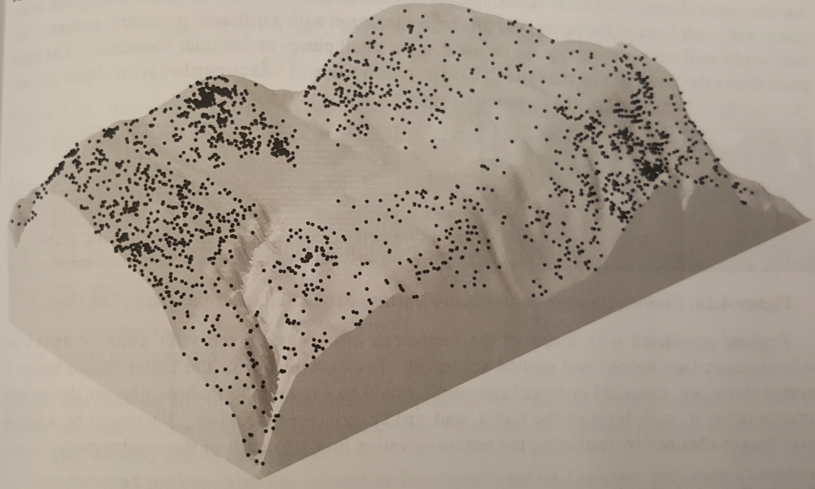
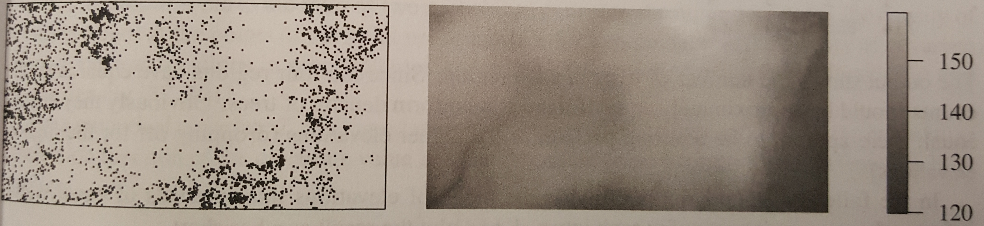
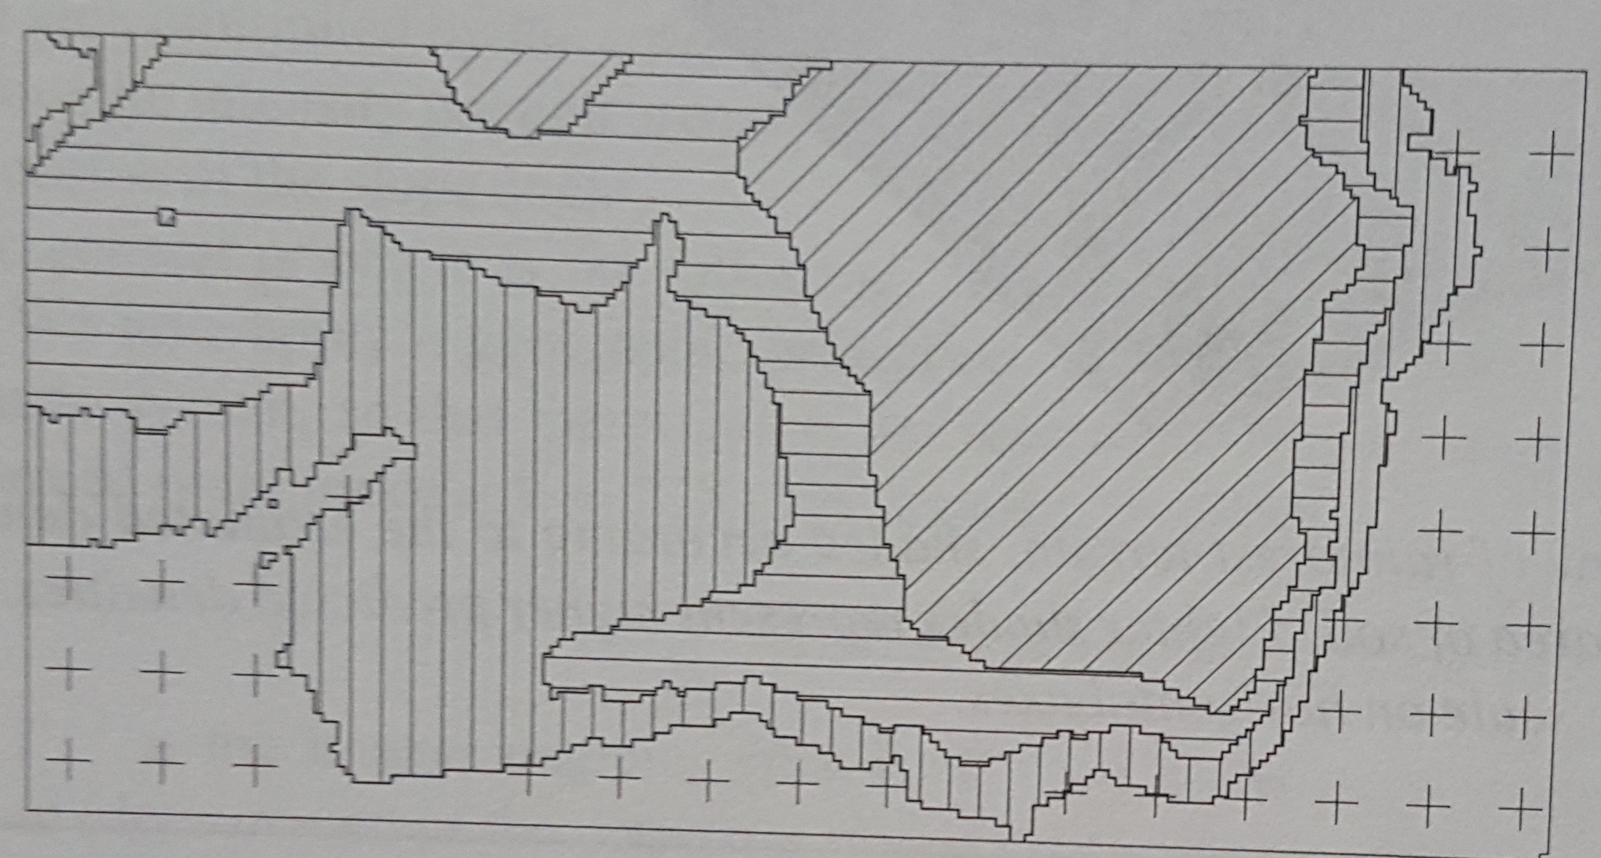
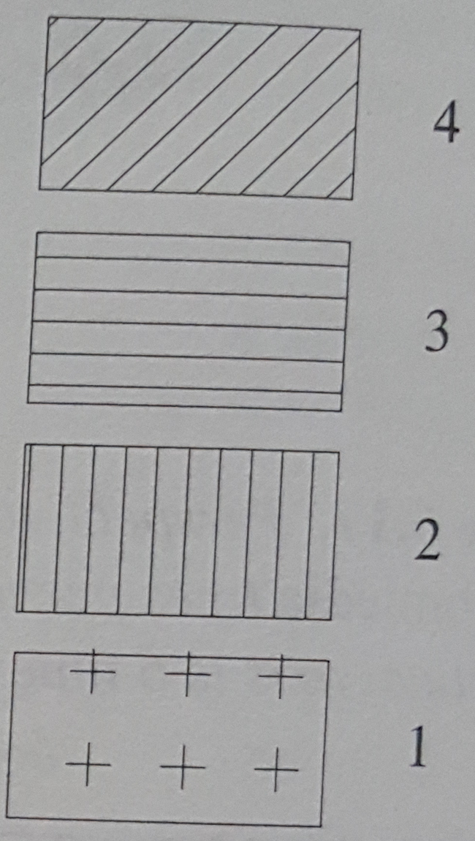
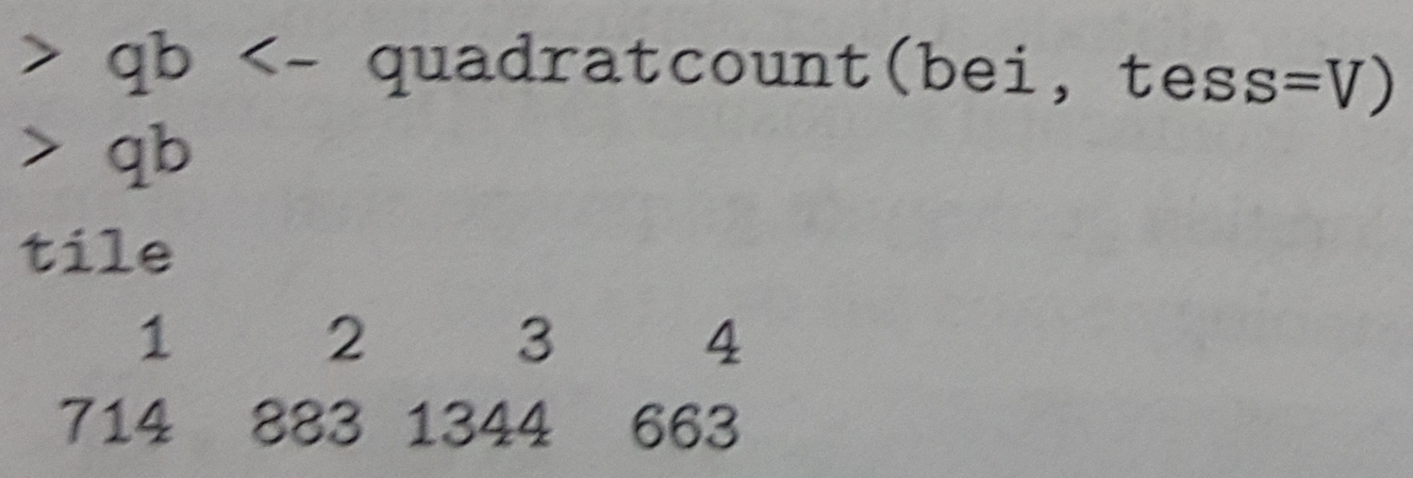
Covariates
Tropical rain forest terrain with visible Beilschmiedia tree locations (Barro Colorado Island)
How the intensity of points depend on the values of covariates?
Does Beilschmiedia trees prefer steep or flat terrain?
Conclude –
Beilschmiedia trees prefer higher elevations
Adrian Baddeley, Ege Rubak, Rolf Turner. Spatial Point Patterns. Chapman & Hall/CRC

Slide 14
Conditional Intensity
Recall CSR
Homogeneity
Independence
Homogeneity can be relaxed
Inhomogeneous Poisson process
Notion of independence is too stringent
Two approaches
Make the intensity random (Cox and Cluster processes)
Make conditional intensity (Gibbs, Strauss, Geyer processes)
If the point process exhibits dependence, probability of observing a point will depend on the rest of the pattern

Slide 15
Gibbs Hard Core Process
u
h
W
Equilibrium process of spatial birth and death process
Each small interval of time δt, each cell has a probability d(t) δt of undergoing cell death, d(t) is the apoptosis rate
Cell division takes place in a small region δa, with probability m(t) δa δt, where m(t) is the mitotic rate
Provided the dividing cells lies h units away, no matter what the initial states are, over long time scales, this process will reach an equilibrium in which any snapshot will be a Gibbs process
Intensity with hard core radius h

Slide 16
Strauss Process
Strauss process is a generalization of the Gibbs process - variations of the basic hard core process
Gibbs hard core process - it is physically impossible for two points to lie closer than h distance apart
Strauss process – improbable than impossible
introduce an interaction parameter γ and t(u,h), number of points less than h
A collection of cells with many pairs of close cells is much less likely than a collection of cells with only a few close pairs.
Strauss process is a generalization of the Gibbs hard core process
Note: γ = 1 is a Poisson process, γ < 1 establishes inhibiting phenotype and γ > 1 can introduce clustering – not allowed
Probability density cannot be greater than 1

Slide 17
Geyer Saturation Process
How to introduce clustering?
Of course, introduce another parameter ☺
s >= 0 – saturation parameter
Note: s = 0 is a Poisson process
γ < 1 introduces inhibiting phenotype
γ > 1 introduces clustering phenotype
s = ∞, is a Strauss process
Thus, Geyer process is a generalization of the Gibbs hard core process

Slide 18
Data Integration

Slide 19
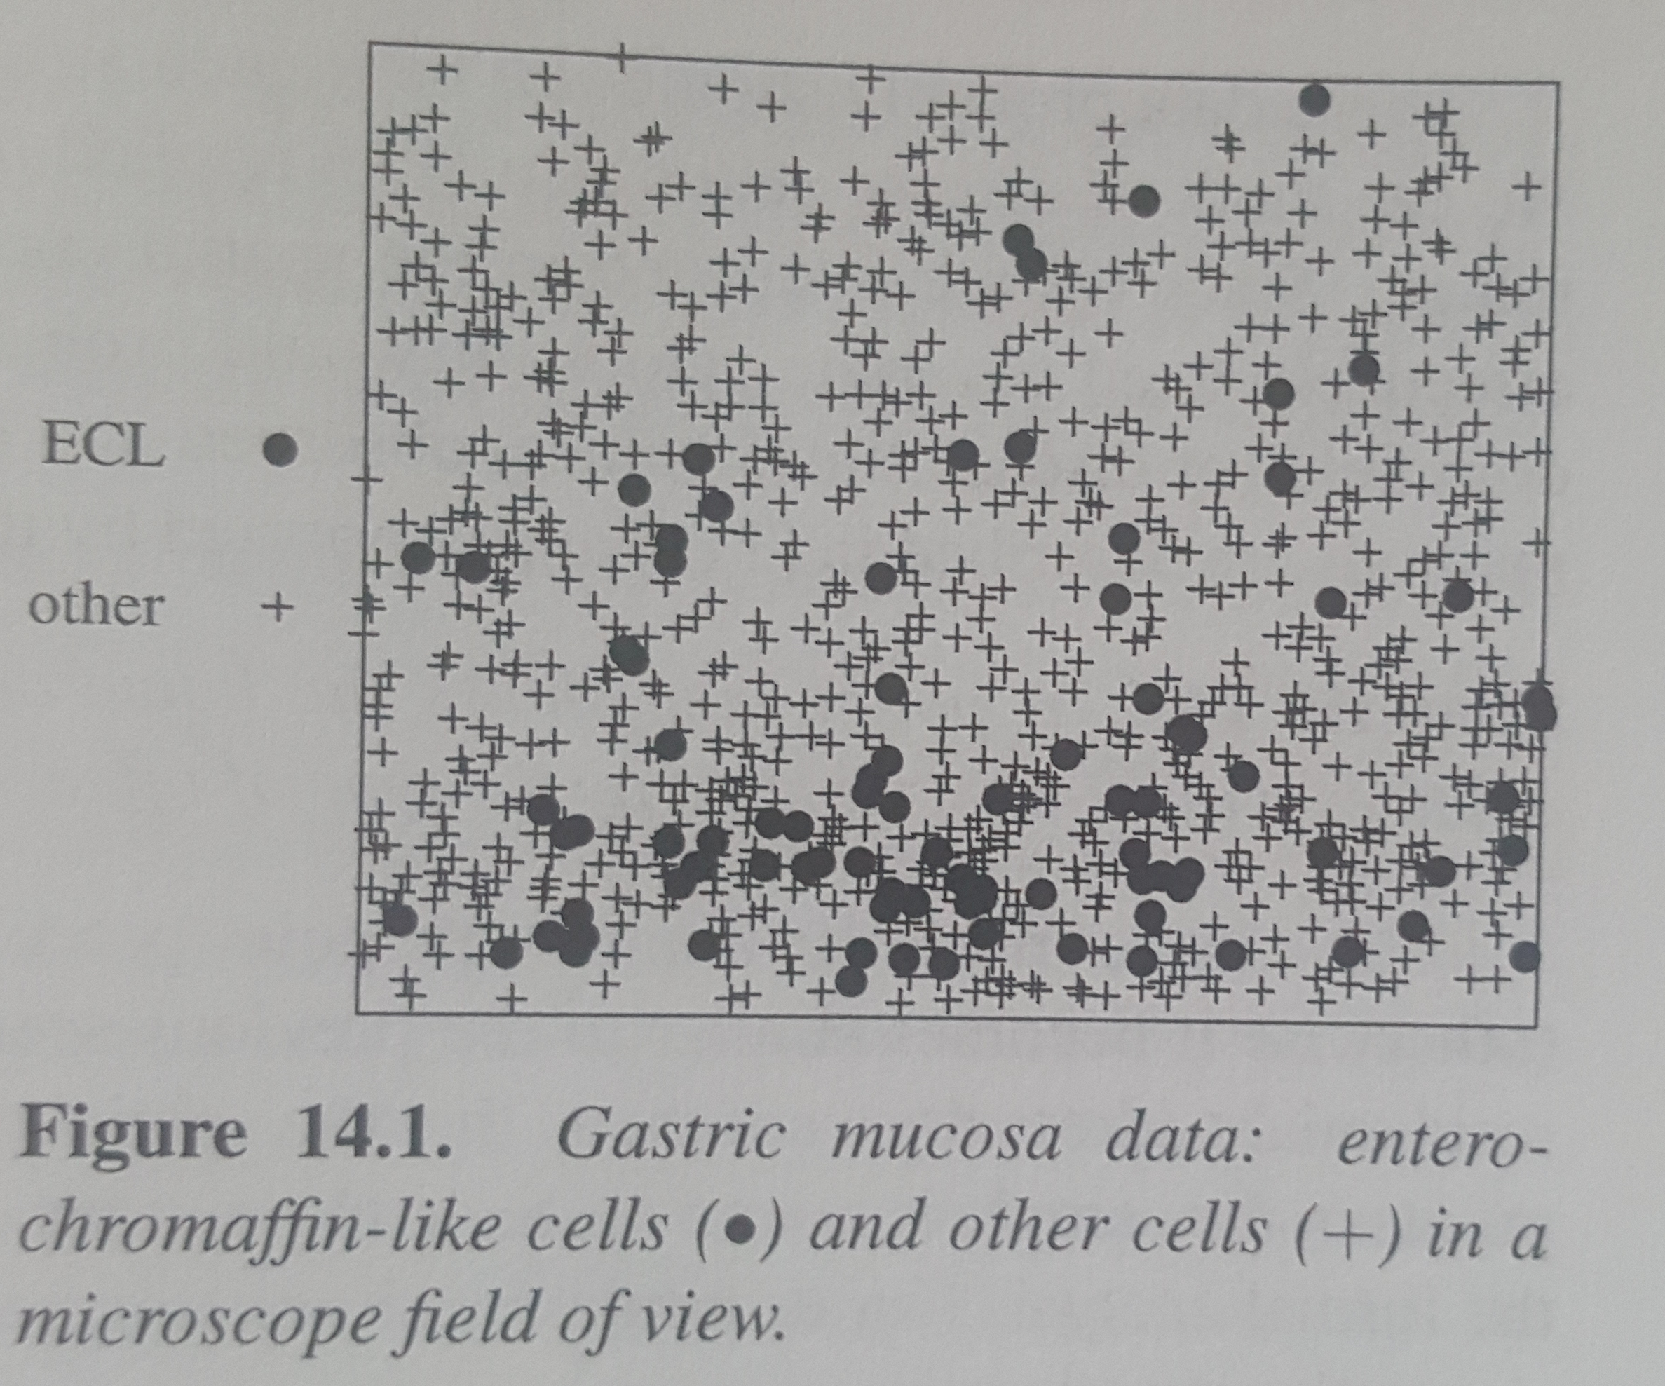
Marked Point Processes
Very powerful framework for biology
integrate attributes of cells with the point process representation of cells
Different from covariates
For example, could be dendritic cells and macrophages
(16, 2)
(12, 0)
(14, 5)
Adrian Baddeley, Ege Rubak, Rolf Turner. Spatial Point Patterns. Chapman & Hall/CRC

Slide 20
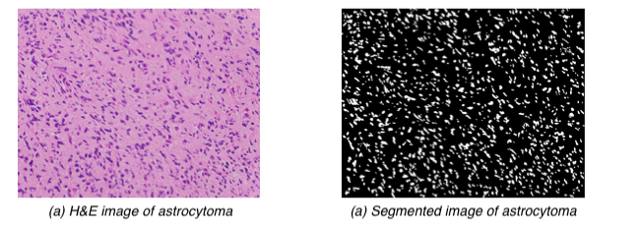
Histopathology Image Segmentation
Segmentation using EBImage¹ and applying the Otsu² method for thresholding
Marked point process representation
1. Pau G, Fuchs F, Sklyar O, Boutros M, Huber W. “EBImage—an R package for image processing with applications to cellular phenotypes.” In: Bioinformatics 26(7) (2010), 979–981.
2. N. Otsu. “A threshold selection method from gray-level histogram.” In: IEEE Transactions on System Man Cybernetics 9(1) (1979), pp. 62–66.

Slide 21
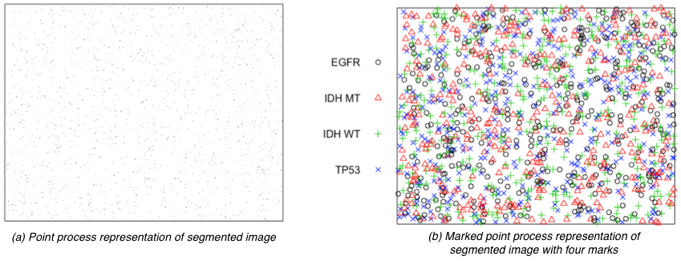
Marked Point Process Representation
Use centroids from the segmented image to create a point process object corresponding to cell locations
Use normal distribution to generate marks (lack of experimental data)
In reality, one can use RNAi, FISH, IHC, single cell, RNA, Exome, MALDI-MSI, genetics, epigenetics or any omics data sets to mark the cells!!!

Slide 22
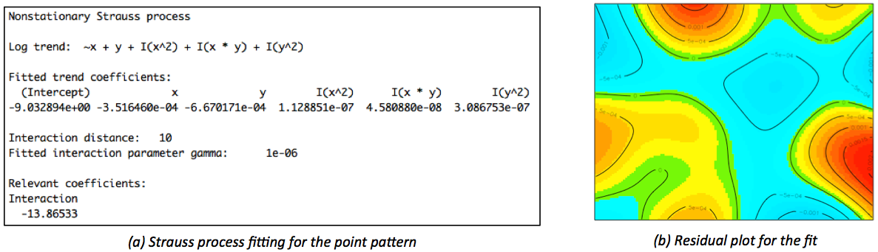
Estimating the Density of Marks
(Density Estimation ) What is the tumor density for a specific mark?
Fit model using Strauss process since the cells are diffuse and infiltrating
residual = (observed) – (fitted)

Slide 23
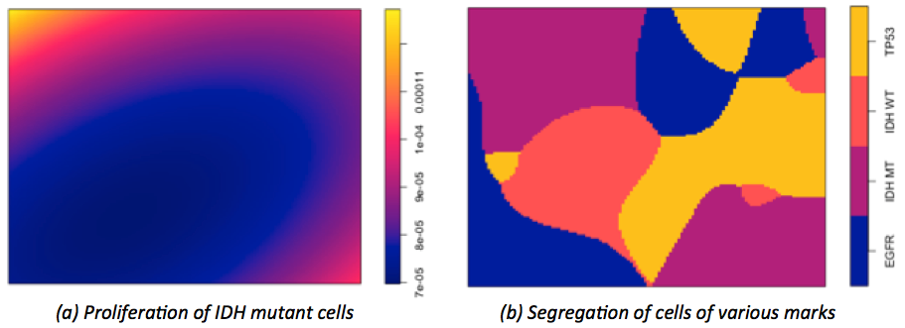
How Cell Proliferation Varies Across Different Marks?
Segregation is the estimation of the density of a point pattern with various marks
Here it denotes the risk of proliferation of various mutation types
One of central questions in point pattern analysis is to identify regions where a particular mark predominates
We can compare proliferation patterns across different experimental conditions

Slide 24
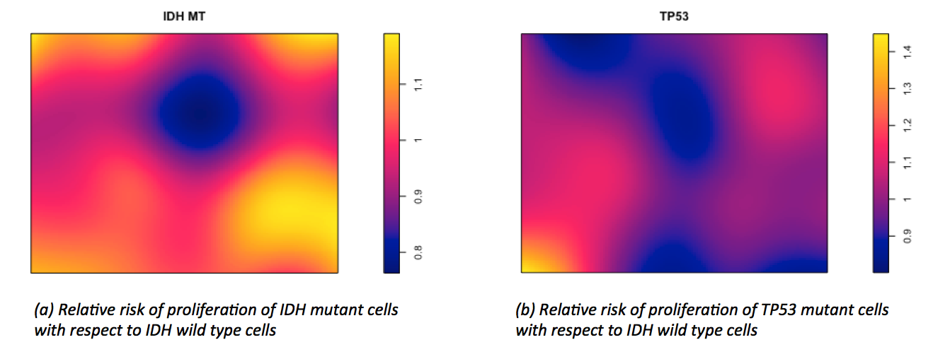
How Fast Cell Does Proliferation Happen for a Particular Mark?
(Relative Risk Estimation ) Do cells of a particular mutation type/mark proliferate faster than any other type?
Relative measure of proliferation is given by relative probability of different types of marks
Epidemiological settings have case-control studies. Relative risk is given by:
Similarly,

Slide 25
What Point Process Does Tumor Heterogeneity Follow?
Gibbs and Strauss’s models are applicable where cell-to-cell ‘repulsion’ interactions define heterogeneity like in diffuse gliomas
In tumors of epithelial origin, tumor micro-environment support clustering of cells in a process (nesting)
Cox, Neyman-Scott, Matérn, Thomas, Gauss-Poisson, Cauchy and several other processes can be applied and compared
Cluster point processes are natural to apply and compare in the setting of clonal evolution
model parent offspring associations, mimic the process of cell division
No such comparative analysis has been performed even purely on histopathology images
i.e., even ignoring marked point process representation
However, comparing control-experiment setup requires just an implementation of any of these methods

Slide 26
An Application of Spatial Point Process

Slide 27
Glioblastoma Multiforme

Slide 28
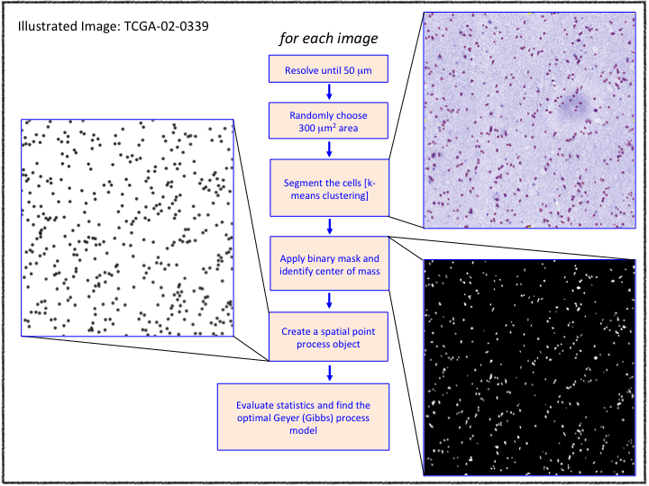
Image Segmentation and Point Process Representation
Downloaded and processed 411 Glioblastoma diagnostic images
Used several open source and stand alone packages available in R, Matlab, QuPath

Slide 29
Question
What is the resolution of the image should we work with?
How do we know 50 μm resolution, 300 μm²area is appropriate for our analysis?

Slide 30
Ripley’s K-function Motivation
Wolf pack example (Central Arctic Region, 1998)
Each pack establishes a hunting territory large enough for its survival (roughly 15 to 20 km in diameter), and actively discourages other packs from invading its territory.
Very clustered at small scales, very dispersed at large scales
Nearest-neighbor techniques can detect only small scale clustering
No way to analyze multiple scales without some form of re-aggregation

Slide 31
K and L-functions
Key idea of K-functions is incorporating “scale” as a variable in the analysis
What is the expected number of point events within distance h from any randomly sampled point event?
This expected number is not very meaningful without specifying the point density, 
It will increase with , Therefore, divide by 
For homogeneous Poisson process (CSR) since the points are independent, the presence of a random point will have no bearing on other points
can be used to determine if the points are random, clustered or dispersed. Provides a scale-free description.
L- function, a commonly used transformation

Slide 32
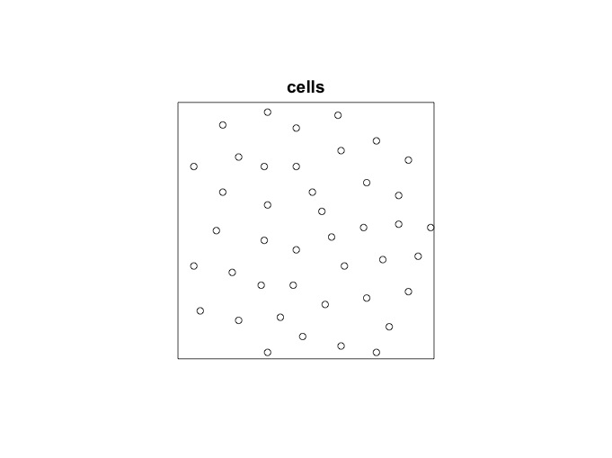
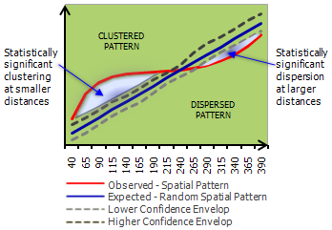
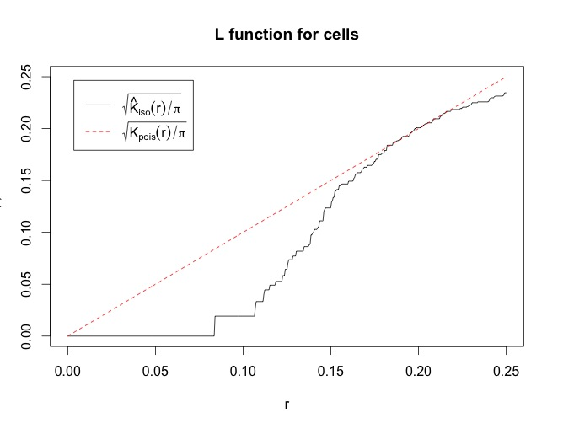
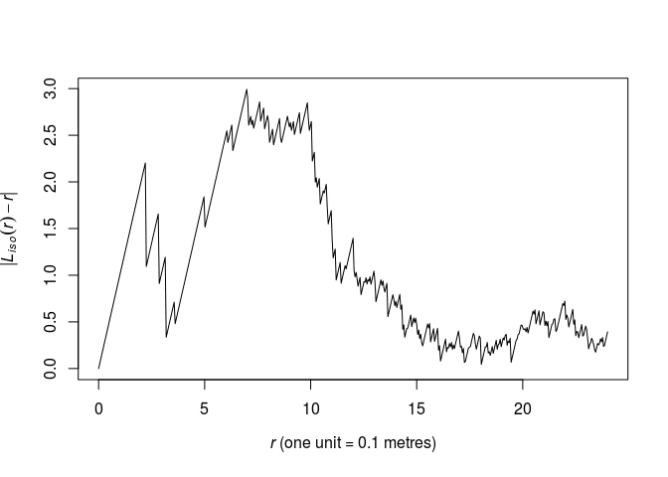
L-function
Cells have a dispersed phenotype
http://resources.esri.com/help/9.3/arcgisdesktop/com/gp_toolref/spatial_statistics_tools/how_multi_distance_spatial_cluster_analysis_colon_ripley_s_k_function_spatial_statistics_works.htm
https://stats.stackexchange.com/questions/57384/ripleys-k-function-and-l-function-for-point-patterns/57388#57388

Slide 33
Two Measures
Optimal L-function and the interaction parameter provided by the Geyer saturation process
Call it as M_{r} and G_{r}
If the cells inhibit each other with the interaction radius G_{r} we can expect the cells be dispersed with the optimal metric L_{r} = opt_{r}|M_{r} –r|
Therefore, analyze the metric (L_{r},G_{r})
G_{r}
L_{r}

Slide 34
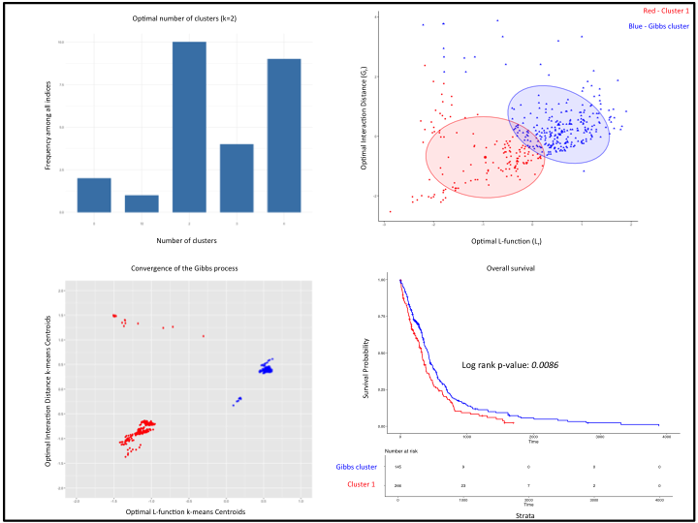
Subgroups in GBM Cells
Unsupervised analysis - cluster the metric (L_{r},G_{r})
Optimal number of clusters – 2 (k-means clustering)
Small sample size with respect to noise - study convergence instead

Slide 35
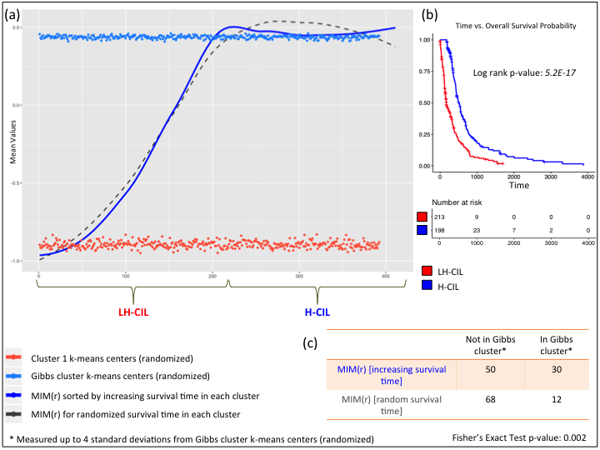
Gibbs Process Determines Survival
Identify signal from noise
Smooth the data using Loess regression

Slide 36
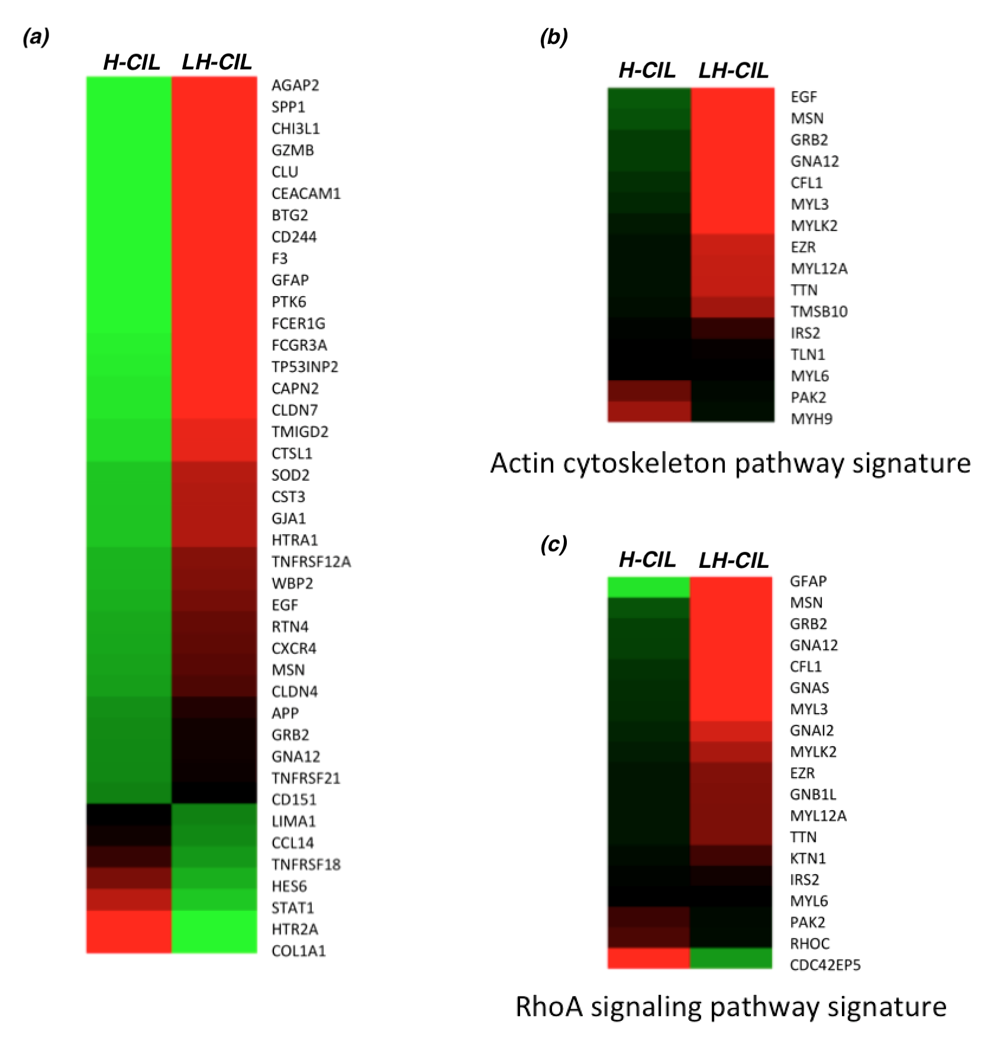
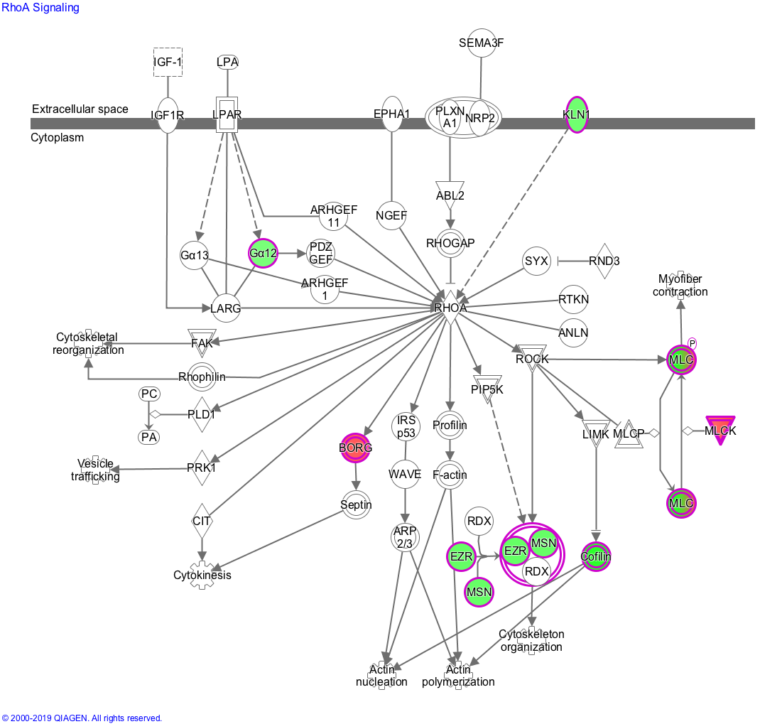
Movement Gene Signatures and Pathways
Analyze RNA-seq. data (69 patients) – 86 gene signature
Key genes in cell movement and proliferation pathways

Slide 37
Contact Inhibition of Locomotion (CIL)
Both CIL and CIP are important mechanisms in cancer progression
CIP is a hallmark of cancer*
However, CIL has been largely ignored since in vivo experiments in tumors has not been carried out
CIL first characterized through the work of Abercrombie and Heaysman in the 50’s.
Two modes of CIL: homotypic and hetrotypic CIL
Loss of heterotypic CIL has been proposed as a mechanism for tumor invasion and metastasis while tumor cells themselves maintain homotypic contact inhibition
Also makes sense from a mathematical perspective
Tumor invasion is a birth and death process of rapidly dividing cells
Representing tumor cells as two-dimensional points, we can expect the tumor tissues in histology slides to reflect realizations of spatial birth-and-death process
Gibbs process is the equilibrium process of spatial birth and death process
* Hanahan D, Weinberg RA (March 2011). "Hallmarks of cancer: the next generation". Cell. 144 (5): 646–74.

Slide 38
Importance of Spatial Point Processes
Very powerful mathematical framework for studying the behavior of cells
Marked point processes with covariates can practically model all aspects of cell behavior through data integration, including omics data
Extract image frames from videos and use spatial point process
Developmental biology (Zebrafish cells diverging to different cell types)
Logical step is to study immune responses through spatial point process framework
Estimate relative risk of proliferation (cancer) and immune responses
Cost effective especially when used with staining techniques
Translational – bench to bedside, scale-free metrics to determine disease states
Can be put under the framework of AI and emergent systems – logical next steps for biology

Slide 39
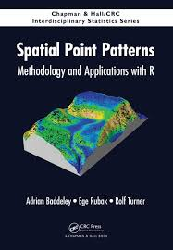
References
Preprint
Lavanya Kannan, Tarjani Agarwal, Matija Snuderl, David Zagzag, Erik Sulman, Jason Huse, and Kasthuri Kannan. Gibbs Process Determines Survival and Reveals Contact-Inhibition Genes in Glioblastoma Multiforme. bioRxiv 608414; doi: https://doi.org/10.1101/608414

Slide 40
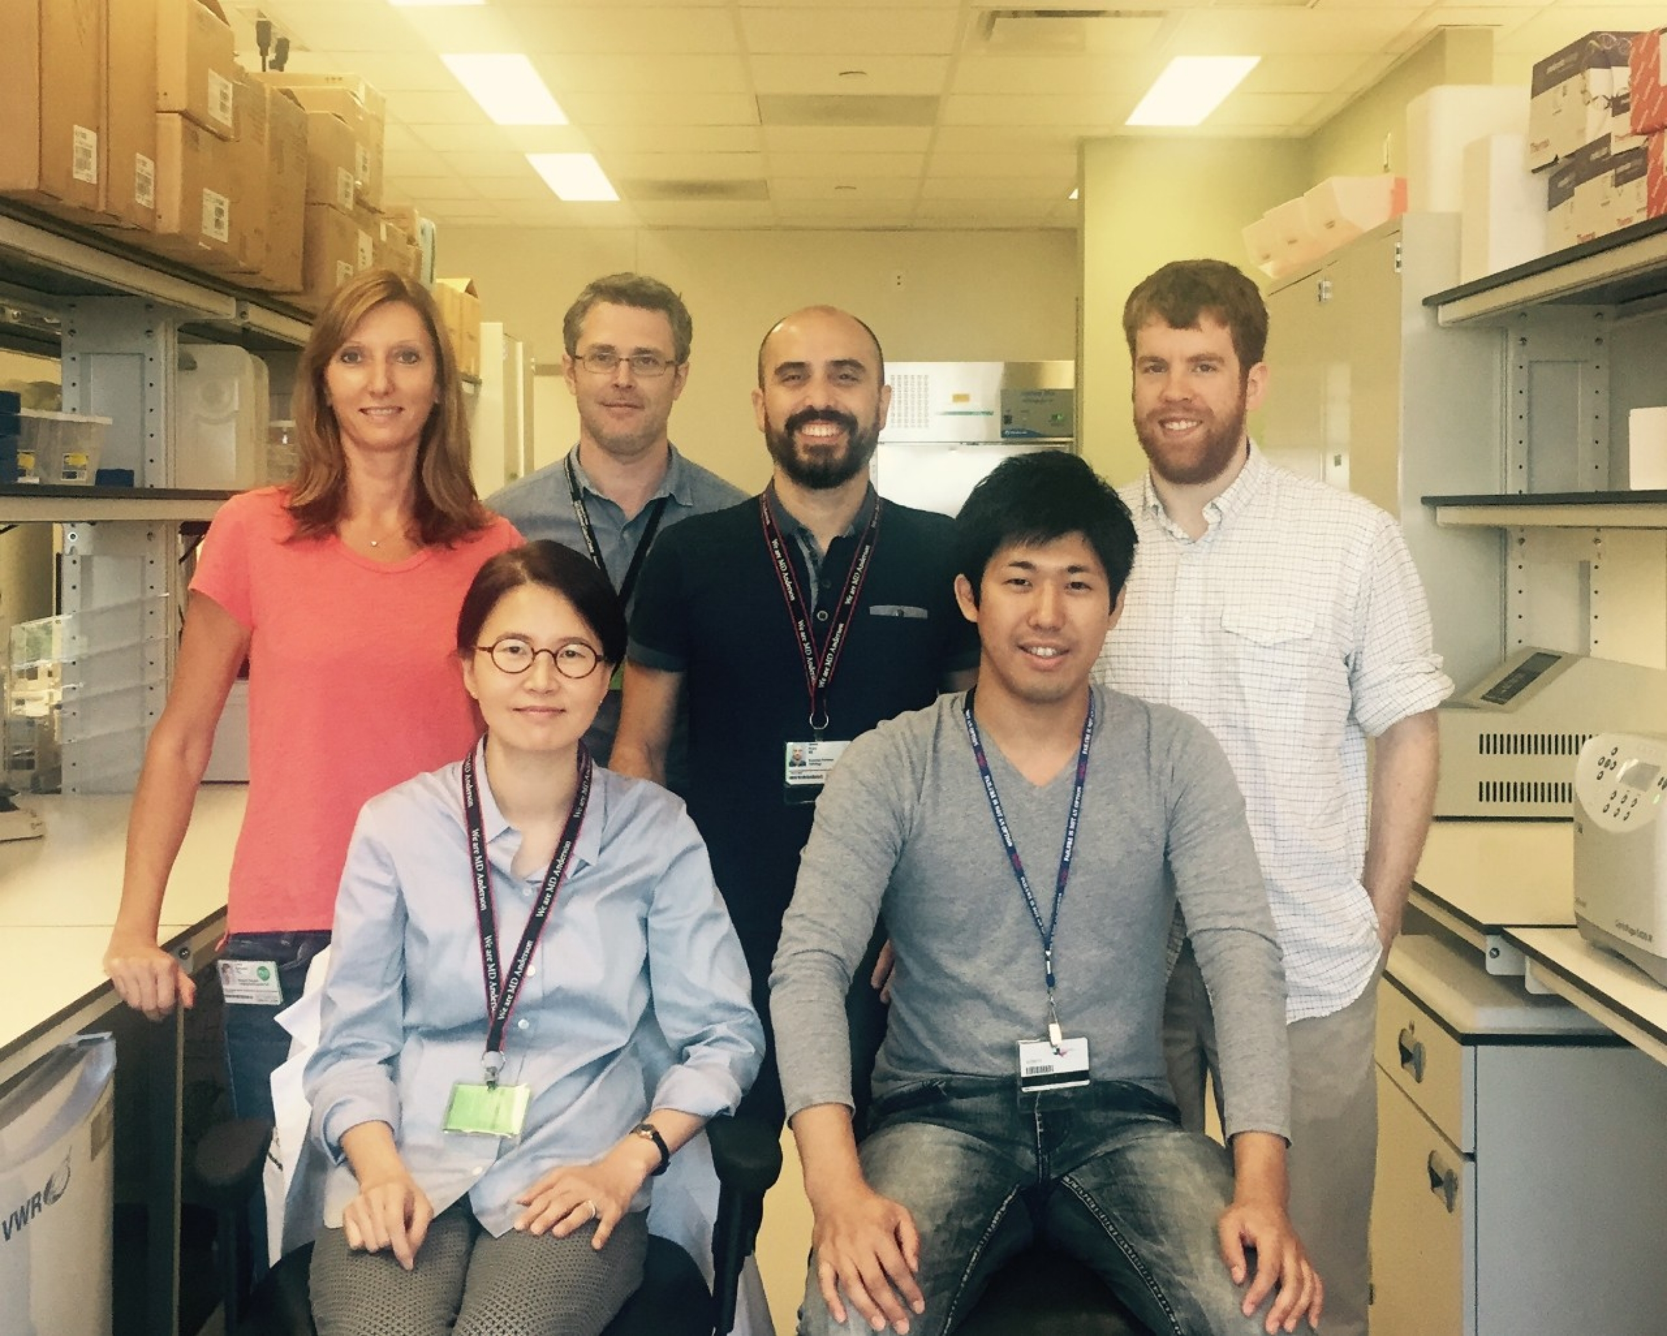
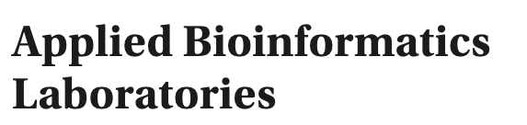
Acknowledgements
Jason Huse, MD, PhD.
Associate Professor of Pathology
Director, Translational Molecular Pathology
MD Anderson Cancer Center
Adriana Heguy, PhD.
Professor of Pathology
Assistant Dean, Division of Advanced Research Technologies
Director, Genome Technology Center
New York University Langone Health

Slide 41
Questions?

